Slide 1
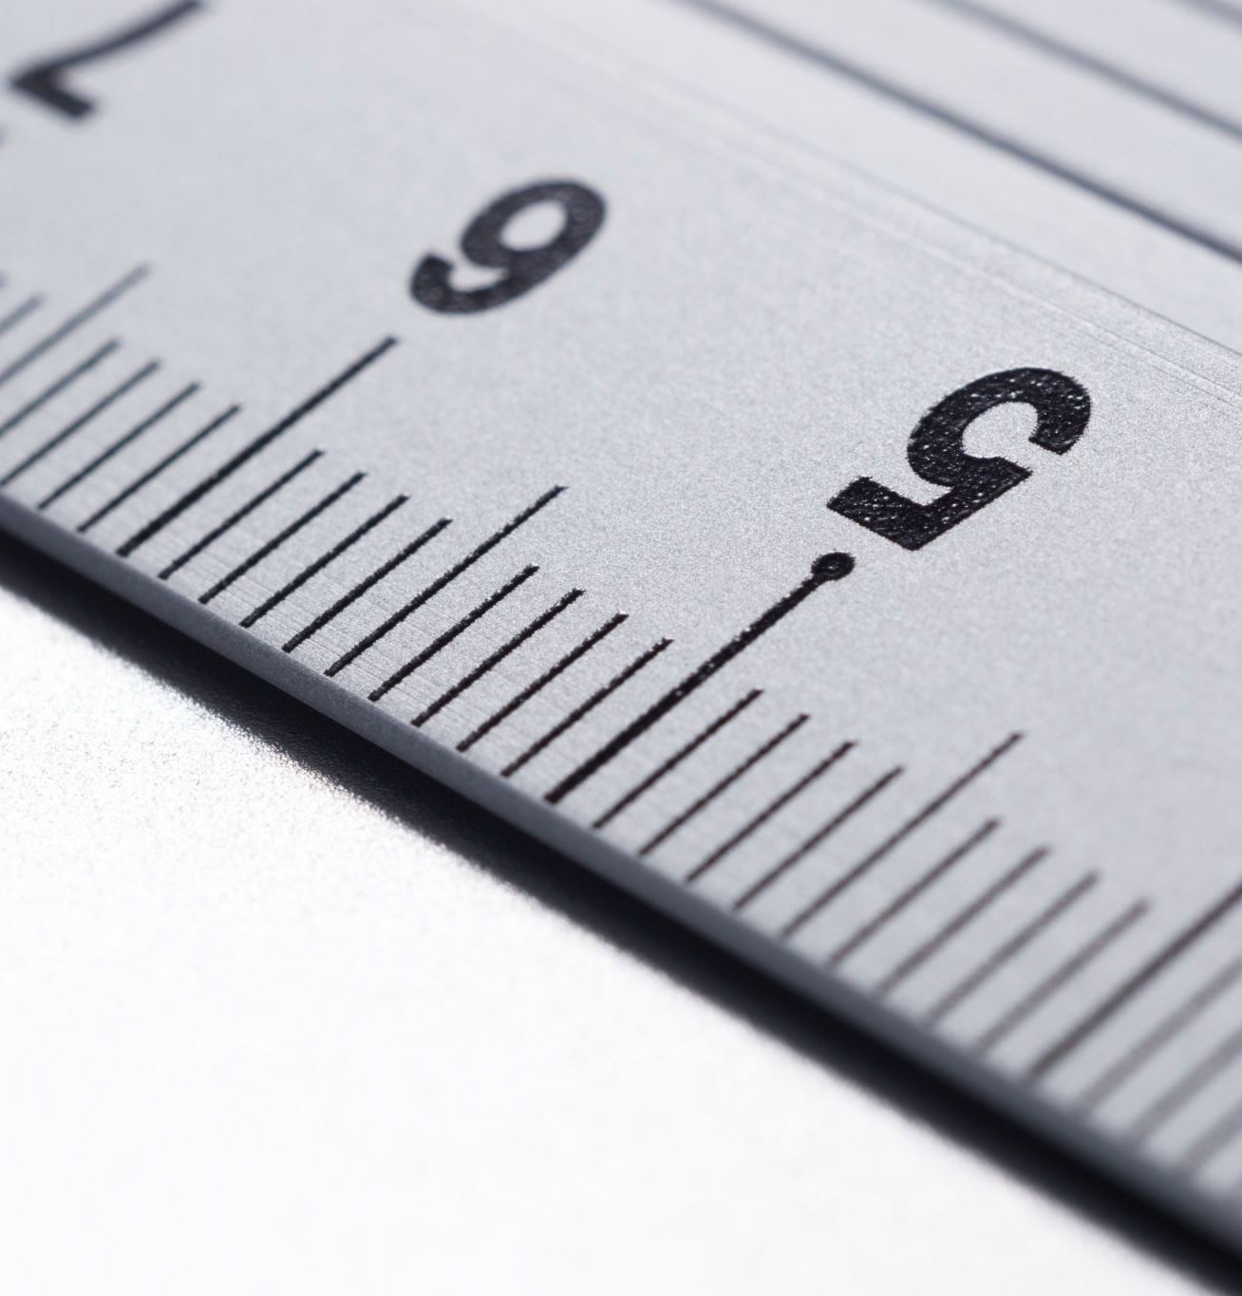
Intro to SVG Part 3: Introducing paths

Slide 2

Rob Larsen
Rob is an experienced front-end engineer, author and open-source contributor.
Rob is co-author of Professional jQuery, the author of Beginning HTML and CSS, the author of The Uncertain Web, from O’Reilly, the author of Mastering SVG and co-author of The HTML and CSS Workshop.
A long-time open-source contributor, Rob currently maintains HTML5-Boilerplate and administers the H5BP organization on GitHub.

Slide 3
What we’ll cover
What the <path> element is and why it's the most important element in SVG.
How to read the commands in the powerful d attribute
Key commands for moving, drawing lines, and creating curves

Slide 4
The <path> element
Notes:
By far the most important element in the SVG specification is the path element.
Path allows you to draw lines and shapes using vectors defined by a series of commands passed
in as an argument to the path element’s d attribute.
One of the biggest roadblocks to early SVG adoption was the lack of a friendly API. Browser support was a bigger issue since you needed the browser to be able to render them, but even with perfect support SVG isn’t the easiest format to work with, using native tools.
The path element is likely the toughest element to work with in the entire specification.
The values you might see in a d attribute can be incredibly difficult to read.
How difficult? The next slide will show the code used to render the S from the SVG logo

Slide 5
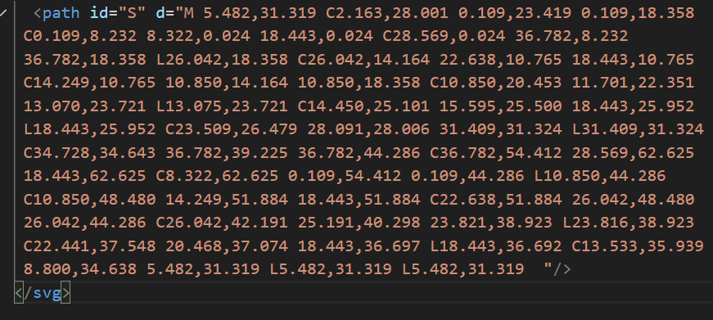
PAth.svg
Notes:
Without knowing what's going on, that's impossible to parse and even knowing the rules
for the d attribute it's difficult to keep track.
There’s a logic there, which is why you can write tools that make SVG magic happen, but a human is going to have hard time keeping track.
Let’s look at a simpler example.

Slide 6
A Path you can Follow!

Slide 7
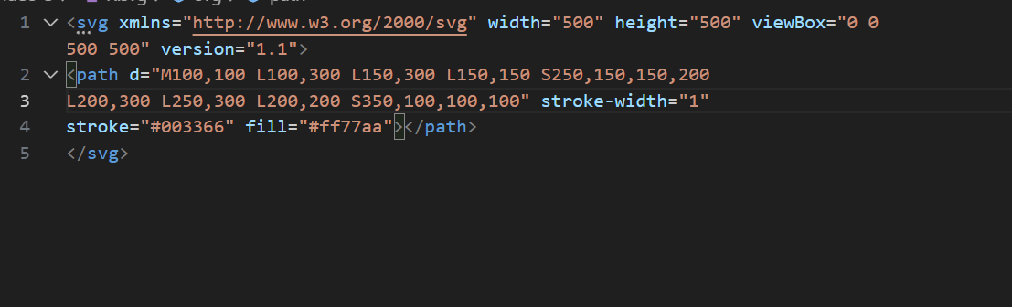
R.svg
Notes:
Let's look at a simpler example so that you can get your head around the syntax. In this
document, we've created a stylized letter R. Here's how to read the instructions of the d
attribute.

Slide 8
Bezier curves

Slide 9
Bezier curves
In SVG, a Bézier curve is a smooth, curved line defined by a set of points. These points are not all on the curve itself; some act as "control points" that influence its shape.
Types of Points
There are two main types of points used to define a Bézier curve:
Anchor Points: These are the start and end points of the curve. The curve will always pass directly through these points.
Control Points: These are points that are not on the curve itself. They act like magnets, pulling the curve towards them and defining its shape, direction, and steepness. Think of them as handles you can pull to bend the line.

Slide 10
Bezier curves
How Control Points Work
The position of the control points determines the curve's tangent (the direction of the line as it leaves an anchor point) and its magnitude (how far the curve bends).
The line between an anchor point and its corresponding control point sets the initial direction of the curve.
The distance of the control point from the anchor point determines how much the curve bends. A control point further away creates a more pronounced, steeper curve.

Slide 11
Translated
(M)ove to point 100,100
Draw a (L)ine to 100,300
Draw a (L)ine to 150,300
Draw a (L)ine to 150,150
Draw a (S)mooth cubic Bézier curve from the current point to the point 250,150 with 150,200 as the second control point. Control points provide directional information used to draw the curve.
Draw a (L)ine to 200,300
Draw a (L)ine to 250,300
Draw a (L)ine to 225,225
Draw a (S)mooth cubic Bézier curve from the current point to the point 100,100
(the starting point) with 350,100 as the second control point.
<svg xmlns="http://www.w3.org/2000/svg" width="500" height=
Notes:
<svg xmlns="http://www.w3.org/2000/svg" width="500" height="500" viewBox="0 0 500 500" version="1.1">
<path d="M100,100 L100,300 L150,300 L150,150 S250,150,150,200
L200,300 L250,300 L200,200 S350,100,100,100" stroke-width="1"
stroke="#003366" fill="#ff77aa"></path>
</svg>

Slide 12
Translated
(M)ove to point 100,100
Draw a (L)ine to 100,300
Draw a (L)ine to 150,300
Draw a (L)ine to 150,150
Draw a (S)mooth cubic Bézier curve from the current point to the point 250,150 with 150,200 as the second control point. Control points provide directional information used to draw the curve.
Draw a (L)ine to 200,300
Draw a (L)ine to 250,300
Draw a (L)ine to 225,225
Draw a (S)mooth cubic Bézier curve from the current point to the point 100,100
(the starting point) with 350,100 as the second control point.
<svg xmlns="http://www.w3.org/2000/svg" width="500" height=
Notes:
<svg xmlns="http://www.w3.org/2000/svg" width="500" height="500" viewBox="0 0 500 500" version="1.1">
<path d="M100,100 L100,300 L150,300 L150,150 S250,150,150,200
L200,300 L250,300 L200,200 S350,100,100,100" stroke-width="1"
stroke="#003366" fill="#ff77aa"></path>
</svg>

Slide 13
USER UNITS

Slide 14
The ViewBox
Notes:
Let’s look at the viewbox and examples of user units in action.

Slide 15
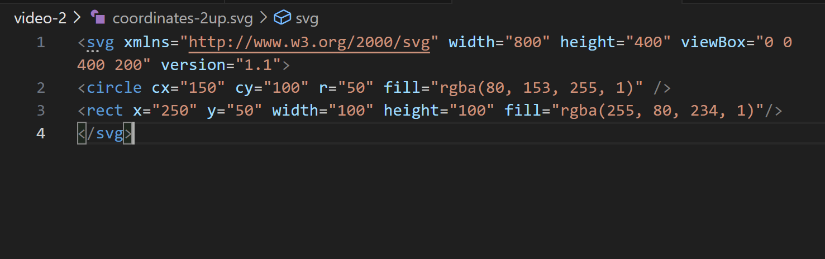
Coordinates-2up.svg
Notes:
To start to understand the way all this works, let’s ask-
What happens if you double the size of the viewport by doubling the height and width of the SVG element- changing nothing else?

Slide 16
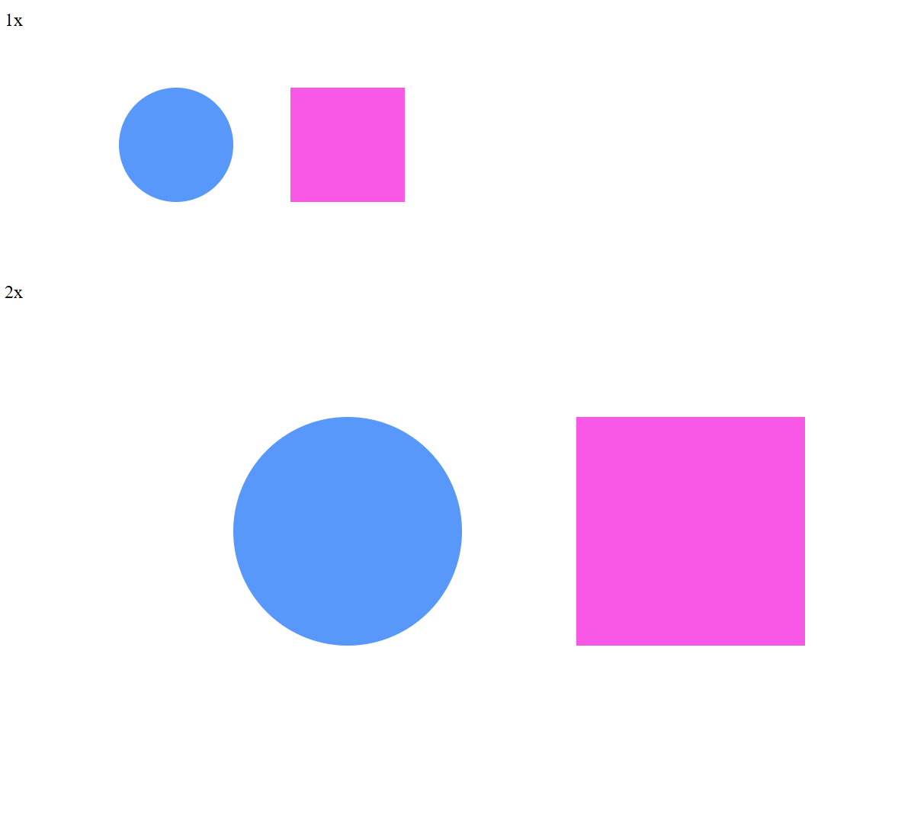
1x and 2x viewport examples
Changing nothing but the height and width scales the image. User units are no longer equivalent to 1 physical pixel, but the calculations are handled automatically by the browser.
Notes:
If you double the height and width, it doubles in viewport size to 800 x 400 pixels and the image scales accordingly. Since the viewBox and all the underlying coordinates remain the same the image scales up perfectly.
Remember, since the rendering of SVG elements happens in the browser and is calculated based on the instructions in your SVG document and not pre-defined pixles (like a JPG or PNG) this means that you can double the size of an image just by changing the height and width and it will scale up perfectly. This is one of the best things about SVG.

Slide 17
Playing with the ViewBox

Slide 18
Viewbox anatomy

Slide 19
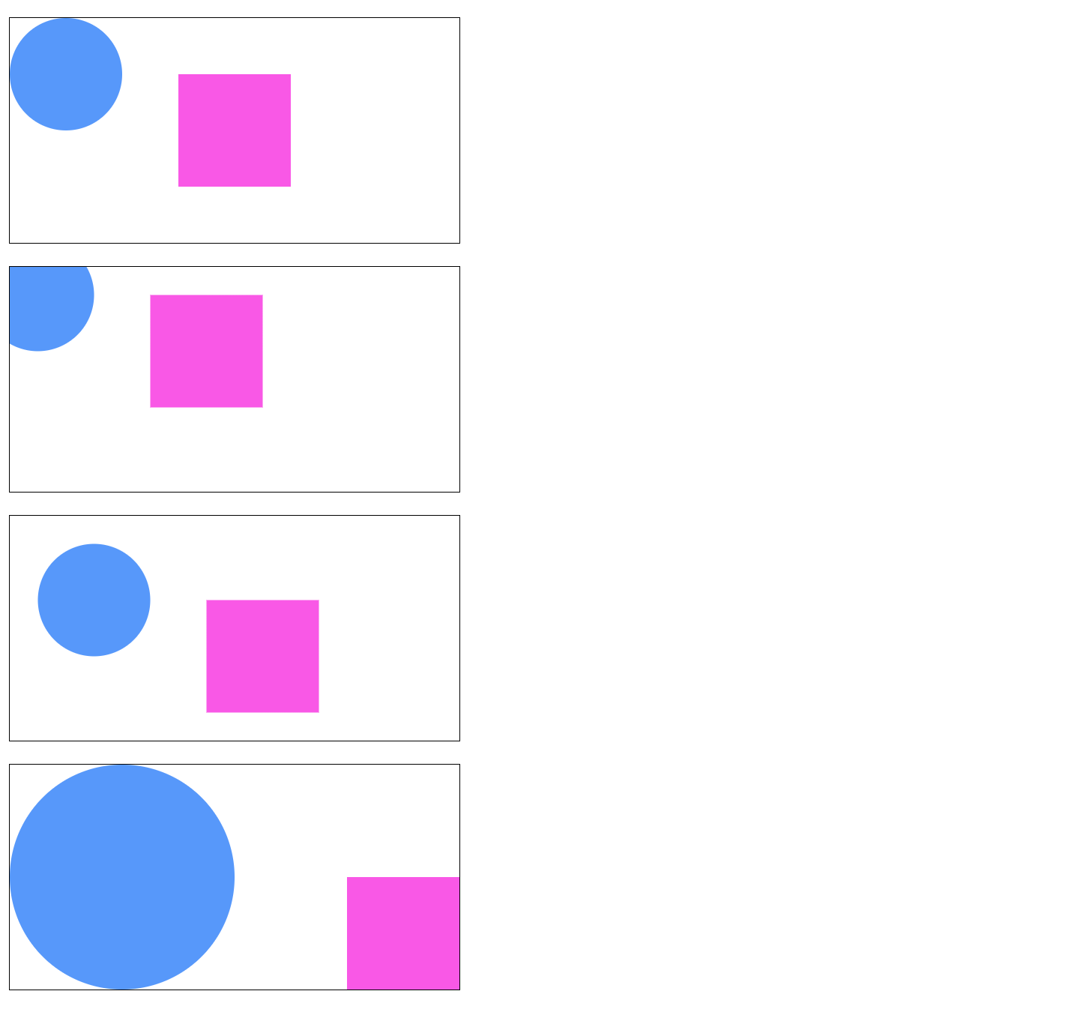
Viewbox-demo-2.html
Notes:
In this example we adjust the viewbox in three different ways.
The first image is the baseline. The origin x and y are set to 0,0 and the height and width match the SVG element’s width (400,200)
The second image offsets the image by negative 25 pixels
The third image offsets the image by a positive 25 pixels
The fourth image sets the origin to 0,0, but changes the viewbox height and width to half of the intrinsic image size (200,100)

Slide 20
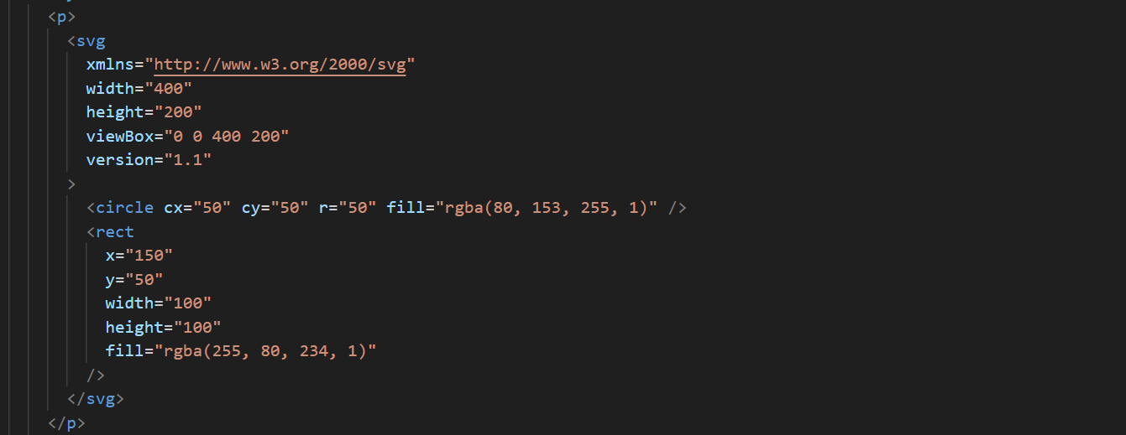
The baseline image
Notes:
This is the baseline the view box is 0 0 400 200.

Slide 21
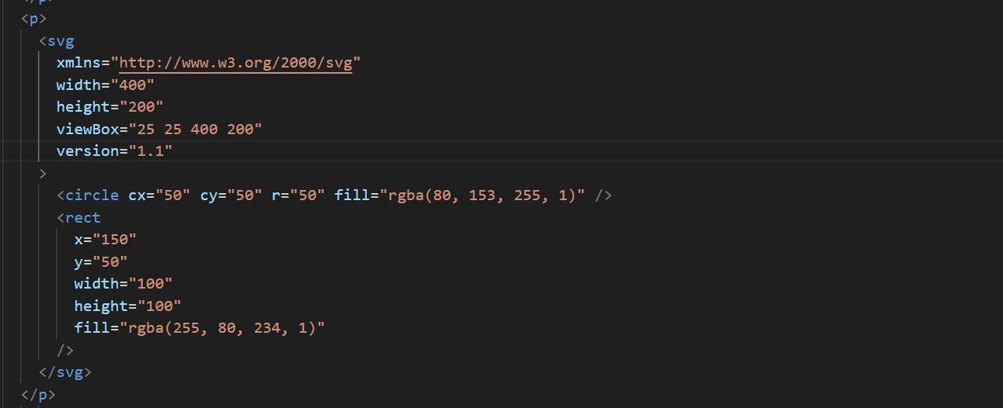
Positive 25 unit offset
Notes:
This pushes the origin up to 25x and 25y while keeping the same viewbox height and width.

Slide 22
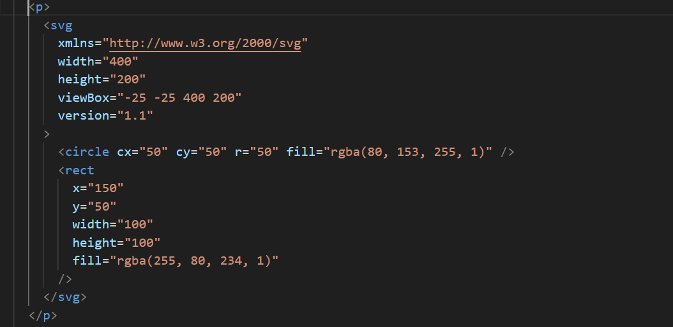
Negative 25 unit offset
Notes:
This pushes the origin back to -25x and -25y while keeping the same viewbox height and width.

Slide 23
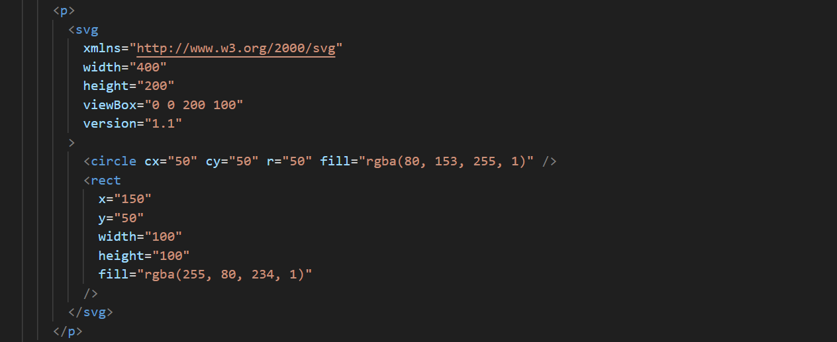
50% ViewBox height and width
Notes:
This shrinks the viewbox width by 50%

Slide 24
Viewbox-demo-2.html
Notes:
This illustrates how the changes we’ve seen change the SVG document. Remember both shapes are defined exactly the same way.

Slide 25
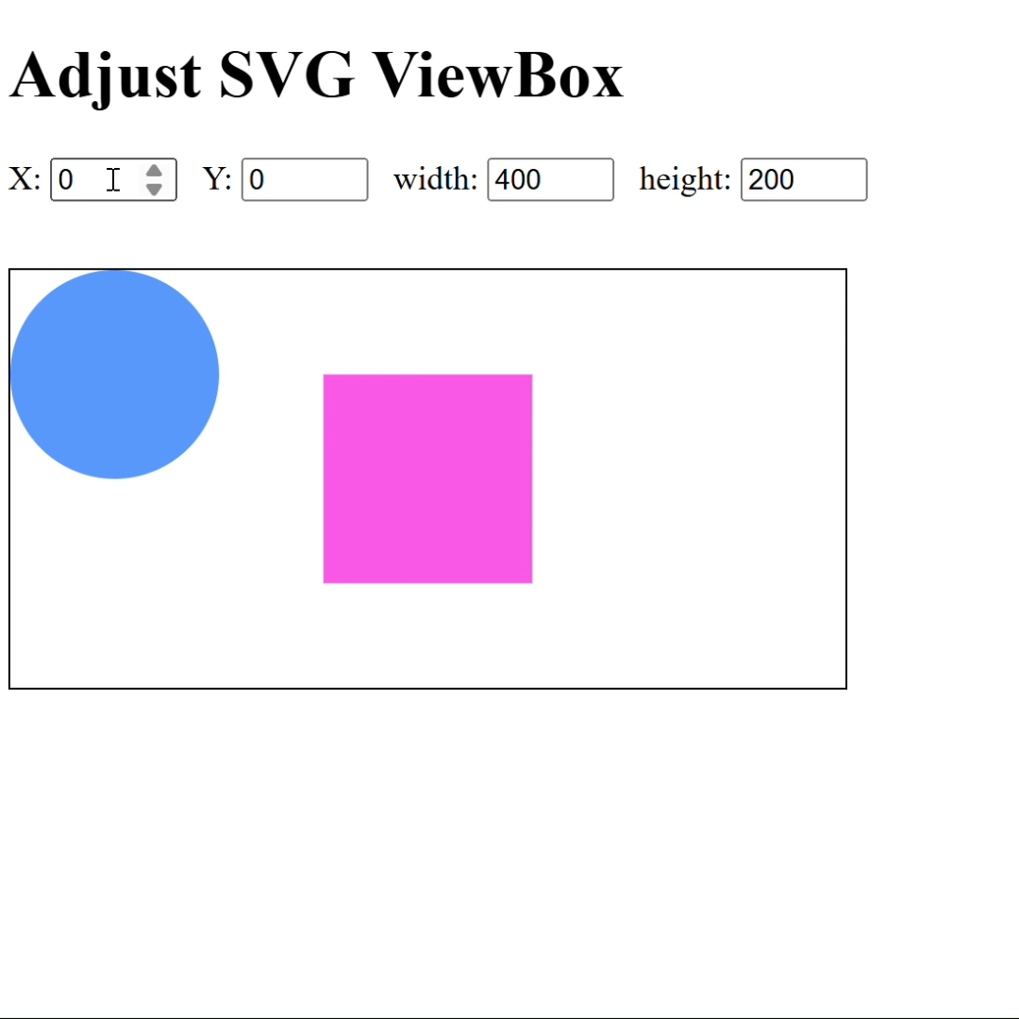
Viewbox demo
Notes:
Here’s a small demo showing how adjusting the viewbox works. In this example it can bring off-screen content onto the screen

Slide 26
What we’ve learned
Key takeaways
The <path> element is the most important in SVG, allowing you to draw anything using vector commands.
Path instructions are passed into the d attribute, which can be dense and difficult to read manually.
We can create shapes by using commands like M (Move), L (Line), and S (Smooth cubic Bézier curve).
Complex paths are typically generated by software or JavaScript, so understanding the syntax is more important than writing it from scratch.

Slide 27
THANK YOU
Rob Larsen
https://htmlcssjavascript.com
https://github.com/roblarsen
https://www.linkedin.com/in/robreact/
Code and slides:
https://github.com/roblarsen/introduction-to-svg

